Slide 1

ADTA 5550-001: Deep Learning with Big Data
PROJECT TITLE
Enhancing Deep Learning Models for Image Recognition in CIFAR-10 Dataset

Slide 2

  Introduction
Objective
Develop and enhance deep learning models to accurately classify images from the CIFAR-10 dataset, progressing from vanilla architectures to sophisticated CNNs with modern optimisation techniques.
Key Research Questions
How do different neural network architectures perform on image classification tasks?
What impact do modern techniques such as data augmentation and advanced optimizers have on model performance?
How can we optimize training procedures for better accuracy and generalization?

Slide 3
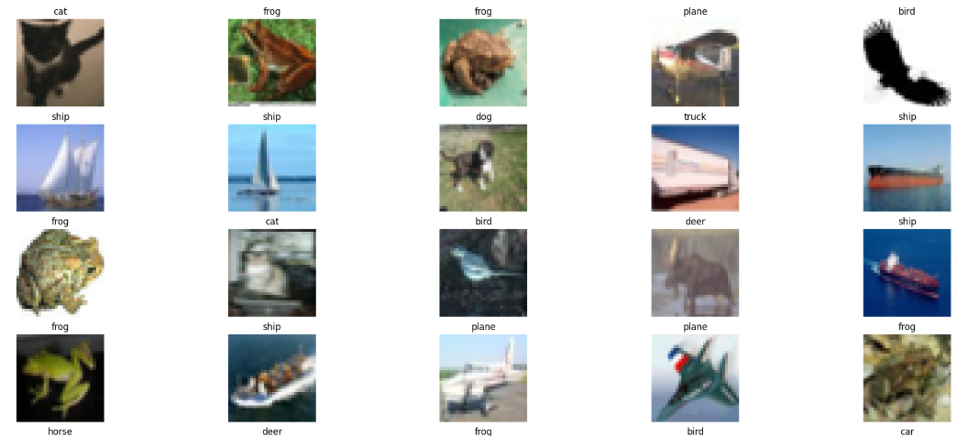
CIFAR-10 Dataset Overview
Data Set: CIFAR-10
Source: www.cs.toronto.edu/~kriz/cifar.html
60,000 color images at 32×32pixel resolution
- 50,000 training images
- 10,000 test images
10 diverse categories
          - Dog, Frog, Horse, Ship, Truck
          - Plane, Car, Bird, Cat, Deer
Figure: Sample images from Training Dataset

Slide 4
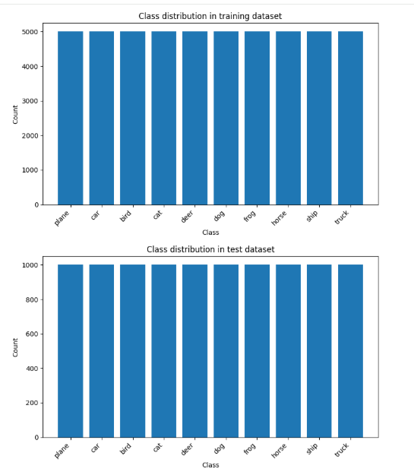
  Dataset Properties
  Uniform distribution across all ten categories
  6,000 images per class
    - 5,000 training images per class
    - 1,000 test images per class
  3 color channels (RGB)
Figure: Image Class Distribution

Slide 5
Approach
Model development strategy :
1. Establish baseline with a fully connected network
2. Implement a basic convolutional architecture
3. Add pooling layers to the CNN for efficiency
4. Incorporate data augmentation
5. Apply advanced optimization techniques
Python Library: PyTorch

Slide 6
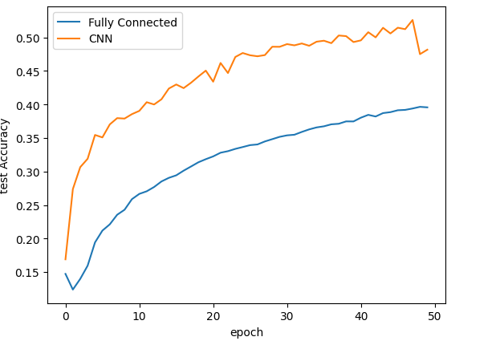
Model Development Progression
Fully Connected Network (FCN)
Three hidden layers of 512 units each
ReLU activation
Vanilla CNN
Three convolutional layers
ReLU activation
16 filters & kernel size 3
Loss function: CrossEntropyLoss
Optimizer: Stochastic gradient descent (SGD)
Epochs: 50

Slide 7
Model Development Progression(contd.)
CNN with MaxPooling
Added dimensionality reduction through
max pooling
Reduces width and height by a factor of 2
CNN with Data Augmentation
Transformed train data:
    - RandomHorizontalFlip
    - RandomCrop
    Three convolution blocks
    - Filters → BatchNorm → ReLU → Filters → BatchNorm → ReLU → MaxPool → Dropout(0.25)
    - Doubled the filters in each block.

Slide 8
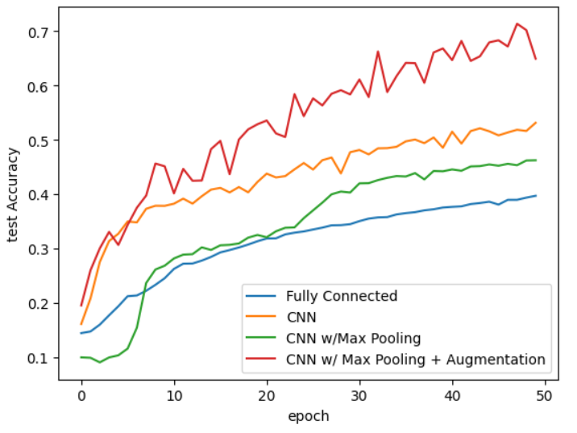
Model Performance

Slide 9
Advanced Training Techniques
StepLR Scheduler
Cosine Annealing
AdamW + Cosine

Slide 10
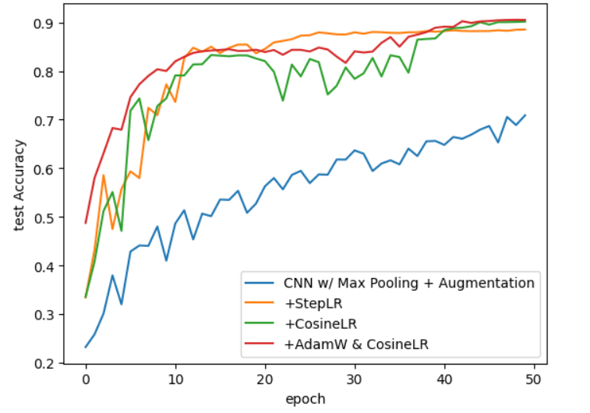
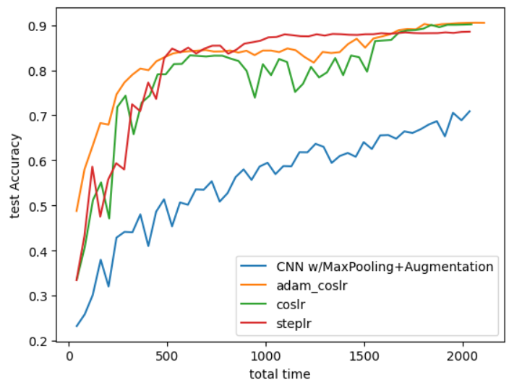
Model Accuracy over epochs and total time

Slide 11
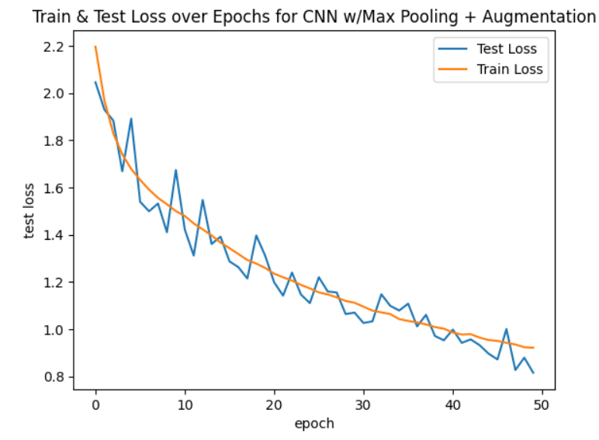
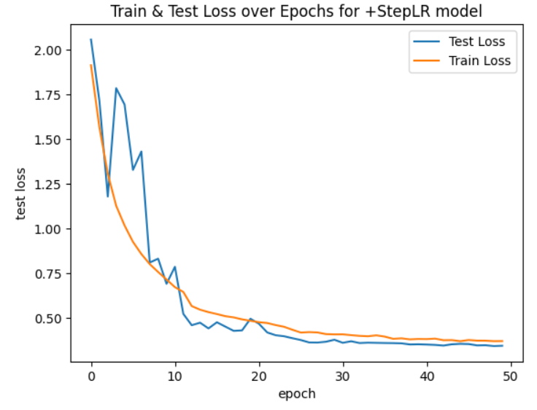
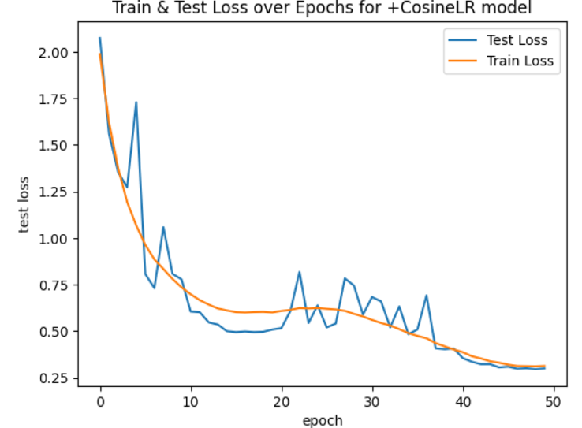
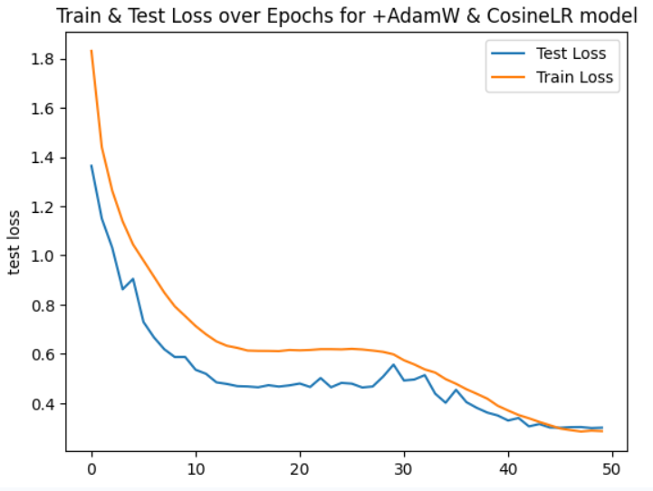
Train and Test loss over epochs

Slide 12
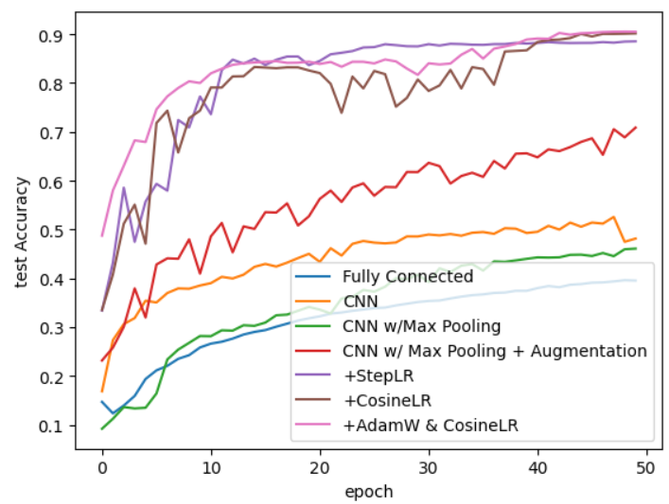
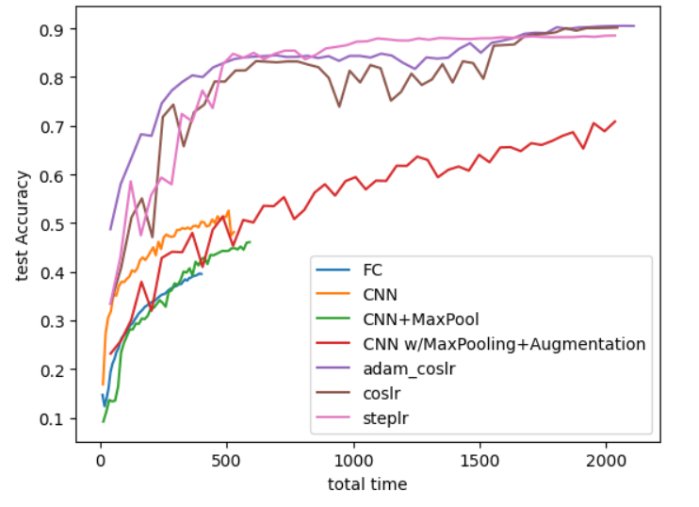
Overall Model Accuracy over epochs and total time

Slide 13
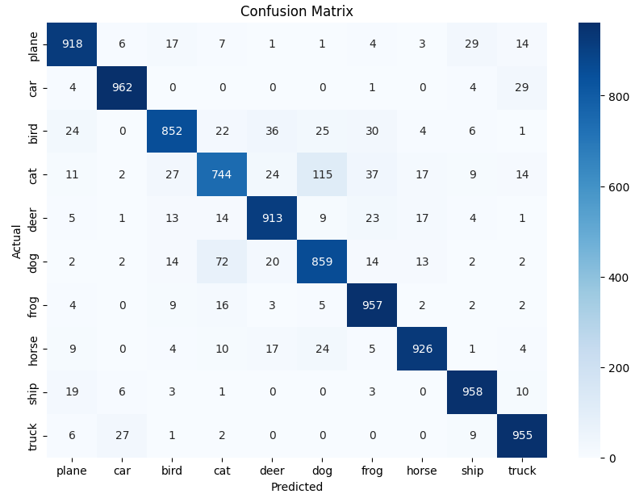
Classification Performance by Class
Strong Performance Classes (>90%)
Car
Ship
Truck
Frog
Horse
Deer
Plane
Moderate Performance Classes (70-89%)
Dog
Bird
Cat

Slide 14
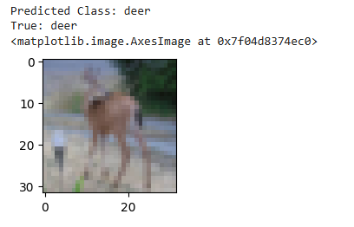
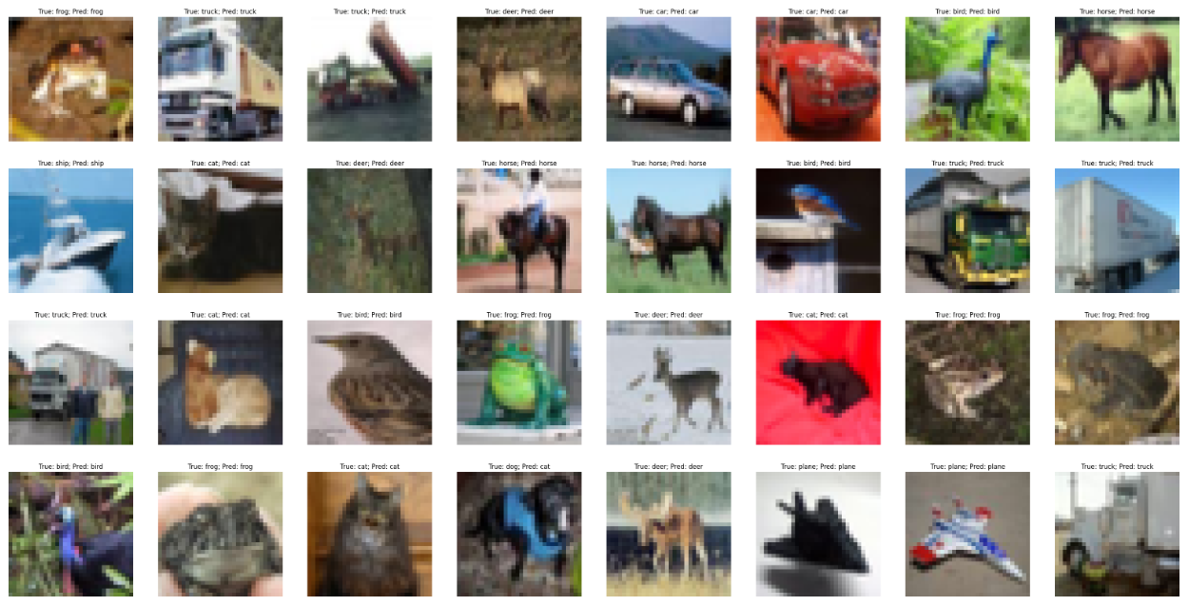
Model Prediction Performance
Single Image Prediction
Image Prediction in a batch

Slide 15

Key Findings
Training model by adjusting different parameters delivered better
Accuracy.
FC and Vanilla CNN provided lower performance accuracy (<50%).
CNN with Data augmentation techniques improved model performance to around 70%.
Using modern training techniques helped achieve 90% model accuracy.
Performance Differences by Class: Not all classes experienced the same performance of the model. It was less accurate on harder, more visually equivalent categories, such as Cats, Dogs and Birds, with 70-89% being the range, but was very accurate (>90) on clear and distinct categories such as Cars, Ships and Trucks.

Slide 16
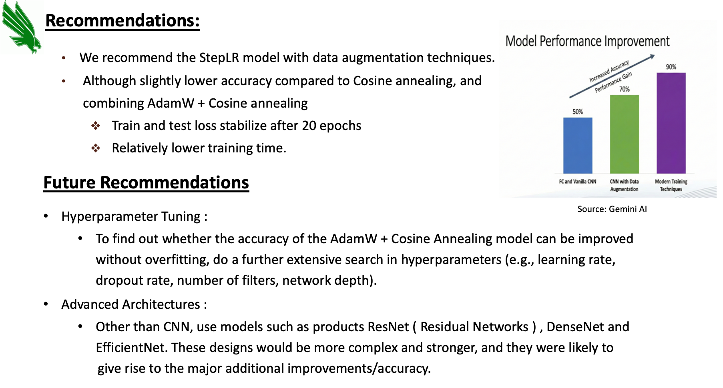

Slide 17
References and Links
For Dataset
  CIFAR-10 Dataset - https://www.cs.toronto.edu/~kriz/cifar.html
For External Code Base
  GitHub code Implementation - https://raw.githubusercontent.com/EdwardRaff/Inside-Deep-Learning/main/idlmam.py
For Course Materials
  Use Lecture slides and materials from ADTA 5550 (Deep Learning with Big Data)
Other Reference links
  CNN for Image Classification - https://www.analyticsvidhya.com/blog/2020/02/learn-image-classification-cnn-convolutional-neural-networks-3-datasets/
  PyTorch Documentation - https://docs.pytorch.org/docs/stable/
  Cosine Annealing LR Scheduler - https://medium.com/@utkrisht14/cosine-learning-rate-schedulers-in-pytorch-486d8717d541

Slide 18
Thank You

